Slide 1
Wi-Fi Modem Configurations
Changes to apply on the modem for port forwarding
Use 192.168.1.1 to access router admin panel.

Slide 2
Port-forwarding
A port forward is a way of making a computer on your home or business network accessible to computers on the internet, even though they are behind a router or firewall. It is commonly used in gaming, security cameras, home automation, and the Internet of Things (IoT).
Port forwards are setup in your router. A forwarded port is also known as open. After you have forwarded a port you have an open port.
What is port forwarding? Port forwarding is a way of allowing people from the internet to connect to you. A port forward puts a device outside of your router, as if it was directly connected to the internet. This is needed for security cameras, torrenting, and optimal gaming experience.
Port forwarding directs your router to send any incoming data from the internet to a specified device on your network. A port forward maps data that is bound to a designated port number to the device or app that you want it to go to. After forwarding a port in your router, incoming data on that port is sent to the destination device that you have chosen.
You might be asking if it is safe to forward ports on your router. The answer is yes as long as you follow a few simple rules. Never forward ports to a PC that does not have a firewall running. Always make sure that you understand why you are forwarding a port. Safe port forwarding.

Slide 3
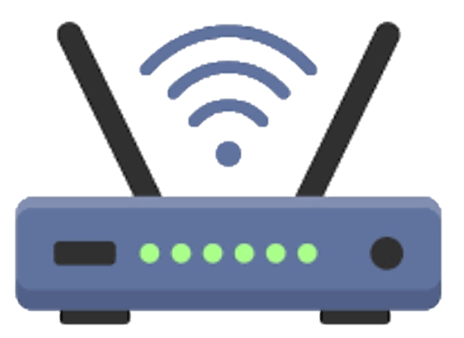
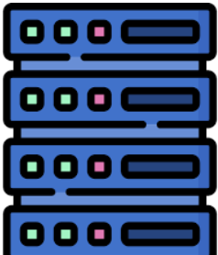



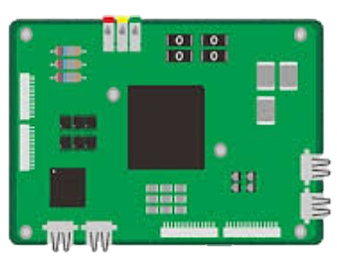
Port-forwarding
Local IP: 192.168.1.1
Public IP: *.*.*.*
Internet
Open on
Port 1883
Port: 1883
*.*.*.*
Port: 80
*.*.*.*
MQTT Broker
192.168.1.3:1883
192.168.1.7:80

Slide 4

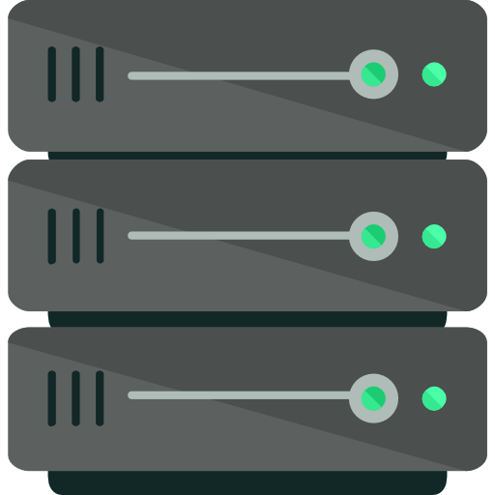

Port-forwarding
MQTT Broker
Internet

Slide 5

Port-forwarding
MQTT Broker
Web Server

Slide 6
Network Checking tools
Command | Purpose
ipconfig | Shows the local IP of the device on the network
Curl https://api.ipify.org/ | Returns the public IP
ip a | Shows MAC address and local IP
ip link show | Shows MAC address and local IP
hostname -I | Shows the Local IP address
URL | Purpose
https://api.ipify.org/ | Public IP
Ip.me | Public IP
https://www.yougetsignal.com/tools/open-ports/ | Open Ports

Slide 7
How To Set Up a Port Forward
There are 4 major steps to setting up a port forward.
1. Assign a static IP address to your computer or device (in the local network).
2. Log in to your router.
3. Forward ports to your computer or device and create a rule in your computer firewall.
4. Test that your port is forwarded properly.
Port forwarding setup
Note: We need to purchase a static public IP address for our modem. Without a static IP, the modem's public IP address may change each time it restarts or reconnects to the network.

Slide 8
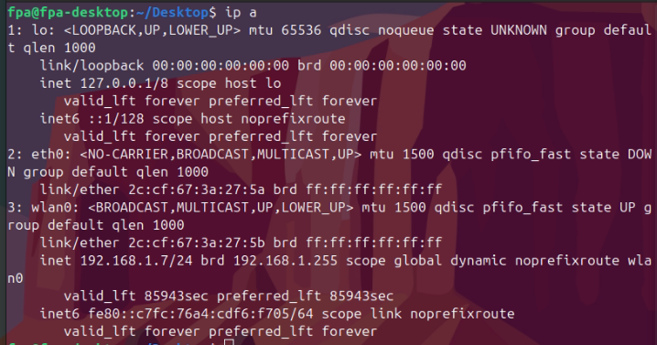
Assign static IP address to Raspberry PI
Find the MAC address of your Raspberry Pi using the command below:
ip a
Look for the MAC address (e.g., b8:27:eb:xx:xx:xx) under your network interface (eth0 for Ethernet or wlan0 for Wi-Fi).
MAC address
IP address
Is connected via Wi-Fi (wlan0)
Has dynamic IP 192.168.1.7
Has Wi-Fi MAC address: 2c:cf:67:3a:27:5b

Slide 9
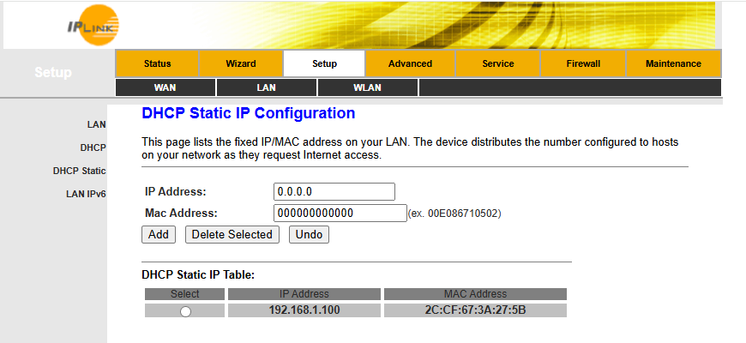
Assign static IP address to Raspberry PI
2. Assign a static IP address to the Raspberry PI using router admin panel
Log into your router (usually at http://192.168.1.1 or http://192.168.0.1).
Go to the DHCP or LAN settings → DHCP reservation or Static lease section. in this case DHCP Static page
Add a rule that maps your Pi’s MAC address to your desired local IP (e.g., 192.168.1.100).
IP address
MAC address

Slide 10
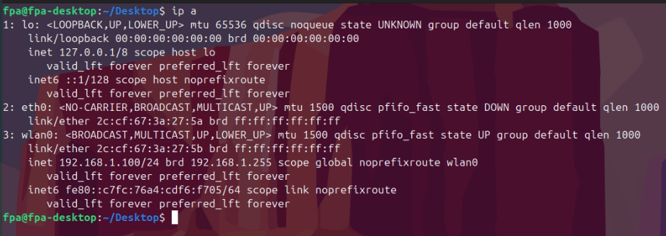
Assign static IP address to Raspberry PI
3. Apply changes
Reboot the Raspberry Pi
Check the ip address
New Assigned static IP address

Slide 11
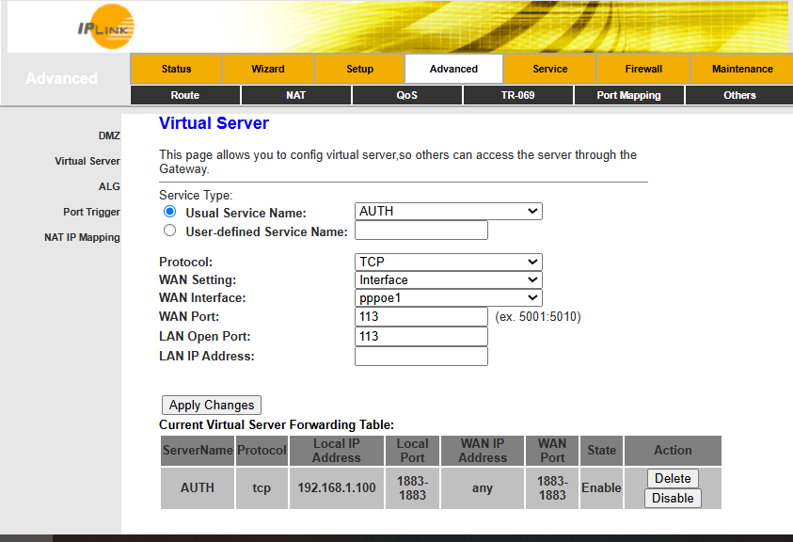
Port forwarding
Log into your router once again.
Go to the port forwarding, virtual server, NAT or Applications & Gaming.
In this case Advanced → NAT → Virtual Server.
Add a new rule using the assigned static IP address and the desired port.
Attribute | Options | Value
Local IP | - | 192.168.1.3
Local Port | - | 1883
WAN Port | - | 1883
Protocol | TCP,UDP | TCP
WAN Interface | pppoe1, pppoe2,any | any

Slide 12
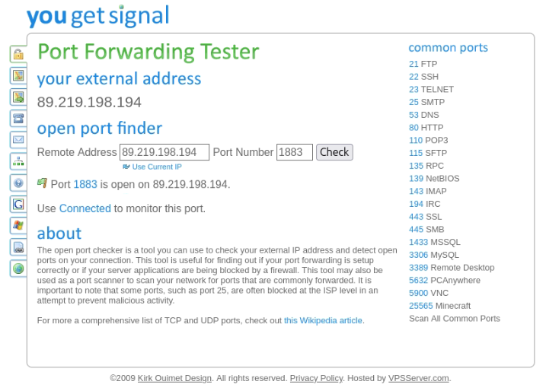
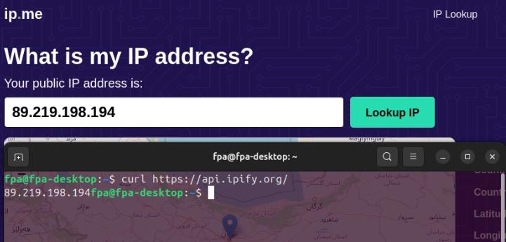
Port forwarding
Test if the port forwarding is working and the set upped port is open on your system
Find the global IP address of the router
Use https://www.yougetsignal.com/tools/open-ports/ to check if the port is open.
Use
Curl https://api.ipify.org/
Command, OR
https://ip.me/
Website

